Slide 1
Bayes Theorem

Slide 2
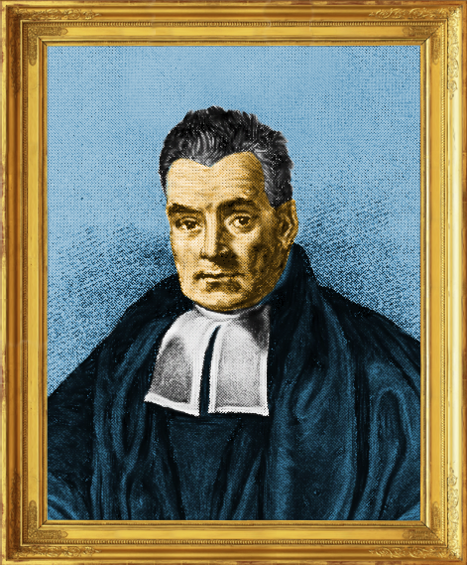
What is Bayes’ Theorem?
Bayes’ Theorem is a way to calculate a conditional probability. It is a simple concept but it has lead to its own branch of statistics (Bayesian) and it is the basis for numerous ML models.
But what is a conditional probability? Let’s talk about conditional probabilities using an example.
Thomas Bayes

Slide 3



Example: Estimating Probability
Example Problem: Have you ever wondered how your phone can predict your next location?
Say your phone collects data at regular time intervals and finds the following:
Your phone might think, “Well, the probability that they are at home is higher so let’s always predict they are going home”. But can your phone do better than this?

Slide 4


Marginal & Joint Probability
What if we consider the time of day?
The marginal probability of A is denoted P(A) and gives the probability of event A occurring.
The joint probability of A and B is denoted P(A and B) or P(A∩B) and gives the probability of both events A and B occurring.
Evening
At Work
30 hr
25%
1 hr
1%
40 hr
33%
Afternoon
At Work
30 hr
25%
24 hr
20%
40 hr
33%

Slide 5



Conditional Probability
What if we consider the time of day?
The conditional probability of A given B is denoted P(A|B) and gives the probability of event A occurring given event B has occurred.
Evening
At Work
30 hr
25%
1 hr
1%
40 hr
33%
Afternoon
At Work
30 hr
25%
24 hr
20%
40 hr
33%

Slide 6


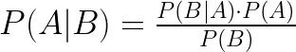
Bayes’ Theorem
So what role does Bayes’ Theorem play in all of this?
If A and B are independent
The key to this is we can estimate P(A | B) from P(B | A). Bayes allows us to incorporate additional information to make better predictions.

Slide 7

Bayes Theorem Example
The police have a breathalyzer test that is able to identify a drunk person as being drunk 100% of the time. This test also incorrectly identifies a non-drunk person as being drunk 5% of the time. (Note - this is called the false positive rate). We also know that 1 out of 100 people on the road are driving drunk.
If someone gets pulled over and gets a positive breathalyzer, what is the probability that the person is drunk?

Slide 8
Bayes Theorem Example
Say 100 people are given the breathalyzer. We know that 1 out of the 100 will be drunk and that person will have a positive breathalyzer. We also know that 5% of the remaining 99 will get a positive breathalyzer even though they are not drunk.
1 Drunk Person
Positive Breathalyzer
~5 Non Drunk People
Positive Breathalyzer
The probability that someone is drunk given a positive breathalyzer is ~1/6 = 17%!

Slide 9
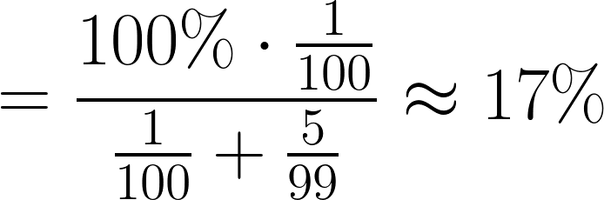
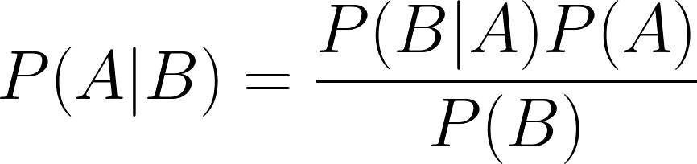
Bayes Theorem Example
Say 100 people are given the breathalyzer. We know that 1 out of the 100 will be drunk and that person will have a positive breathalyzer. We also know that 5% of the remaining 99 will get a positive breathalyzer even though they are not drunk.
1 Drunk Person
Positive Breathalyzer
~5 Non Drunk People
Positive Breathalyzer
The probability that someone is drunk given a positive breathalyzer is ~1/6 = 17%!
A = Person is Drunk
B = Positive Breathalyzer

Slide 10
Bayes’ Theorem Example 2
1% of women at age forty who participate in routine screening have breast cancer.
80% of women with breast cancer will get positive mammograms. 9.6% of women
without breast cancer will also get positive mammograms. A woman in this age
group had a positive mammography in a routine screening. What is the probability
that she actually has breast cancer?
All Women
All Women
Women with cancer (A)
Women with Positive Mammogram (B)
A
A
B

Slide 11
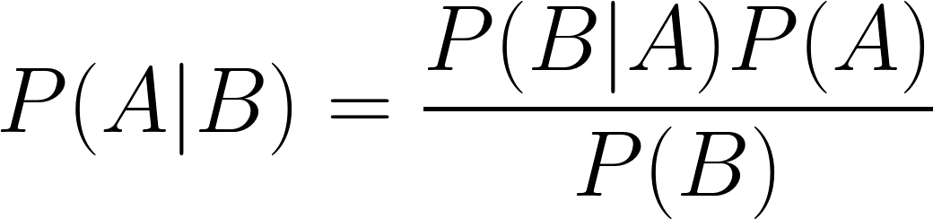

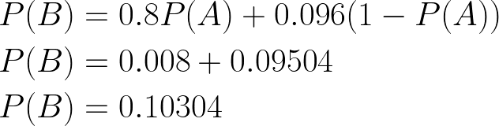
Bayes’ Theorem Example 2 Cont.
Let A be the event the woman has breast cancer, and B be the event a women gets a positive mammogram.
1% of women have breast cancer.
80% of those women get a positive mammogram, and 9.6% of the women without breast cancer get a positive mammogram too.

Slide 12

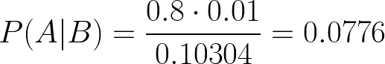
Bayes’ Theorem Example Cont.
We can get P(B | A) straight from the problem statement. Remember that 80% of women with breast cancer get a positive mammogram.
Now we can plug everything into Bayes’ theorem.
There is about a 7.8% chance of actually having breast cancer given a positive mammogram.

